Slide 1
C# Advanced Videos Review

Slide 2

Publish-Subscribe Model
Publisher
subscription
subscription
Delegate
Method
Method
Method
Subscriber
Subscriber
Subscriber
Subscribers subscribe for something (like an event) by passing methods to a delegate provided by publisher

Slide 3
Publish-Subscribe Model
Publisher
publish
publish
Delegate
Method
Method
Method
Subscriber
Subscriber
Subscriber
Publisher invokes subscribers method on that specific event

Slide 4
Example.
#Delegate
public delegate void EventHandler(object sender, EventArgs e);
#Adding “lblSaveContact_Click” method to “EventHandler” delegate
picBoxSaveContact.Click += new EventHandler(lblSaveContact_Click);
#lblSaveContact_Click method
private void lblSaveContact_Click(object sender, EventArgs e)
{
//Doing something
}

Slide 5
Read only fields initialization
Constructor or inline initializing
Const fields initialization
inline initializing

Slide 6
Object
initializer
Always runs at object
creation
Sets some properties after object creation
Constructor

Slide 7
Enums
By flag attribute
Can have many values
Inherit
from
Int, byte, long, …

Slide 8

Static vs dynamic polymorphism
static void Main(string[] args)
{
Person e = new Employee();
print(e);
print((Employee) e);
}
static void print(Person p)
{
Console.WriteLine("A person");
}
static void print(Employee e)
{
Console.WriteLine("An epmloyee");
}
Static
Method overload
Output

Slide 9

Static vs dynamic polymorphism
class Person
{
public virtual void SayHello()
{
Console.WriteLine("Person says hello");
}
}
class Employee : Person
{
public virtual void SayHello()
{
Console.WriteLine("Employee says hello");
}
}
static void Main(string[] args)
{
Person e1 = new Employee();
e1.SayHello();
((Employee)e1).SayHello();
}
Static
Virtual method of parent which is not overridden
Output
virtual
virtual new

Slide 10

Static vs dynamic polymorphism
class Person
{
public virtual void SayHello()
{
Console.WriteLine("Person says hello");
}
}
class Employee : Person
{
public override void SayHello()
{
Console.WriteLine("Employee says hello");
}
}
static void Main(string[] args)
{
Person e1 = new Employee();
e1.SayHello();
}
Dynamic
Method override
Output

Slide 11

Type class
Each object has this member :
+ GetType() : Type
Type : Run-time type of an object
Ex.
Shape s = new Circle(5);
Type t = s.GetType();
foreach (var p in t.GetProperties())
{
Console.WriteLine(p.Name);
}
Out

Slide 12
Two interfaces
Enumerable
Enumerator
Any thing that is countable
Something with specifics that enumrates
Members
Members
GetEnumerator()
Current
reset
MoveNext()

Slide 13
Multi Threading
 | Read Access | Write Access
A UI control in a thread rather than the one which control is created in.
✔

Slide 14
LITTLE POP-UP WINDOWS MEETING INFOGRAPHICS
MERCURY
1
It is the closest planet to the Sun
2
MARS
Despite being red, Mars is very cold
SATURN
3
It is a gas giant full of hydrogen
4
EARTH
The Earth is the planet we live on

Slide 15
LITTLE POP-UP WINDOWS MEETING INFOGRAPHICS
MERCURY
VENUS
JUPITER
MARS
Mercury is the smallest of them all
Venus is the second planet to the Sun
Jupiter is the biggest one in the System
Despite being red, Mars is actually cold

Slide 16
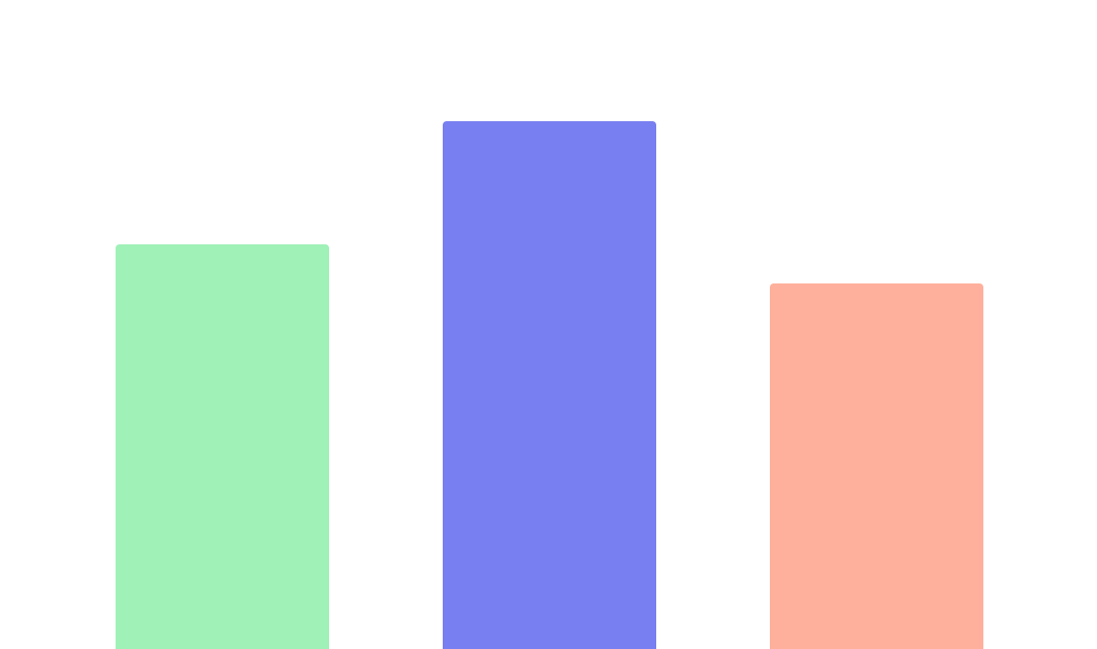
LITTLE POP-UP WINDOWS MEETING INFOGRAPHICS
MERCURY
100%
Mercury is the closest planet to the Sun
80%
70%
SATURN
Saturn is composed of hydrogen and helium
JUPITER
Jupiter is the fifth planet and the biggest one
Follow the link in the graph to modify its data and then paste the new one here. For more info, click here

Slide 17
LITTLE POP-UP WINDOWS MEETING INFOGRAPHICS
 | URANUS | VENUS | MARS | EARTH
Mercury is the closest planet to the Sun
Jupiter is the biggest planet of them all
Saturn is composed mostly of hydrogen
The Earth is the third planet from the Sun

Slide 18
LITTLE POP-UP WINDOWS MEETING INFOGRAPHICS
MARS
SATURN
Despite being red, Mars is a cold place full of iron oxide
Saturn is composed mostly of hydrogen but also of helium
MERCURY
VENUS
Mercury is the closest planet to the Sun of them all
Venus has a beautiful name and high temperatures

Slide 19
LITTLE POP-UP WINDOWS MEETING INFOGRAPHICS
VENUS
Venus has a very beautiful name
MARS
Despite being red, Mars is very cold
EARTH
The Earth is the planet we live on

Slide 20
LITTLE POP-UP WINDOWS MEETING INFOGRAPHICS
2
SATURN
1
It is the planet with rings
3
EARTH
VENUS
The Earth is the planet with life
Venus has a very beautiful name
4
MARS
Mars is a cold place full of iron

Slide 21
LITTLE POP-UP WINDOWS MEETING INFOGRAPHICS
MERCURY
SATURN
MARS
It is the planet with rings
Mars is a cold place full of iron
It is the smallest of them all
Saturn is also a gas giant
Venus has a beautiful name

Slide 22
LITTLE POP-UP WINDOWS MEETING INFOGRAPHICS
01
NEPTUNE
It is the farthest from the Sun
02
SATURN
It is composed of hydrogen
03
JUPITER
It is a gas giant and the biggest
04
MARS
Despite being red, Mars is cold
05
VENUS
It is the second planet from Sun

Slide 23
LITTLE POP-UP WINDOWS MEETING INFOGRAPHICS
JUPITER
Jupiter is the biggest planet
VENUS
Venus is the second planet
MARS
Despite being red, it is cold
NEPTUNE
It is the farthest planet from Sun

Slide 24
LITTLE POP-UP WINDOWS MEETING INFOGRAPHICS
EARTH
MERCURY
The Earth has life
It is the smallest planet
MARS
SATURN
It is a very cold place
It’s composed of helium
VENUS
JUPITER
It has a beautiful name
Jupiter is the biggest

Slide 25
LITTLE POP-UP WINDOWS MEETING INFOGRAPHICS
JUPITER
EARTH
Jupiter is the fifth planet and the biggest in the System
The Earth is the only planet of them all that has life in it
MARS
MERCURY
Despite being red, Mars is a cold place full of iron dust
It is the closest planet to the Sun and the smallest one

Slide 26
LITTLE POP-UP WINDOWS MEETING INFOGRAPHICS
 | MON | TUE | WED | THU | FRI
MERCURY | Mercury is the closest planet to Sun
SATURN |  |  | Saturn is mostly composed of hydrogen
EARTH |  | The Planet Earth is where we all live on
JUPITER |  |  |  | Jupiter is the biggest one in the Solar System

Slide 27
LITTLE POP-UP WINDOWS MEETING INFOGRAPHICS
MERCURY
VENUS
It is the closest planet to the Sun
Venus is the second planet
SATURN
MARS
It is mainly made of hydrogen
Despite being red, Mars is very cold
JUPITER
EARTH
Jupiter is the biggest planet
The Earth is where we live on

Slide 28
LITTLE POP-UP WINDOWS MEETING INFOGRAPHICS
80%
50%
90%
25%
EARTH
MARS
MERCURY
JUPITER
The Earth is the planet we live on
Despite being red, Mars is very cold
It is the closest planet to the Sun
Jupiter is the biggest planet

Slide 29
LITTLE POP-UP WINDOWS MEETING INFOGRAPHICS
VENUS
MARS
1
Venus is the second planet from the Sun
Despite being red, Mars is a cold place
2
SATURN
JUPITER
3
Saturn is mainly made of hydrogen
Jupiter is the biggest planet
4
EARTH
MERCURY
5
The Earth is the planet we live on
It is the closest planet to the Sun
6

Slide 30
LITTLE POP-UP WINDOWS MEETING INFOGRAPHICS
VENUS
EARTH
Venus is the second planet
The Earth is the planet we live on
SATURN
JUPITER
It is known for its many rings
Jupiter is the biggest planet

Slide 31
LITTLE POP-UP WINDOWS MEETING INFOGRAPHICS
EARTH
The Earth is the third planet from the Sun
SATURN
Saturn is composed of hydrogen and helium

Slide 32
LITTLE POP-UP WINDOWS MEETING INFOGRAPHICS
MERCURY
VENUS
It is the closest planet to Sun and the smallest one
Yes, Venus has a beautiful name and high temperatures
JUPITER
EARTH
It is the fifth planet and the biggest one in the Solar System
The Earth is the only planet with life in the Solar System

Slide 33

LITTLE POP-UP WINDOWS MEETING INFOGRAPHICS
15%
MERCURY
It is the smallest planet
20%
VENUS
It has high temperatures
65%
JUPITER
Jupiter is the biggest
Follow the link in the graph to modify its data and then paste the new one here. For more info, click here

Slide 34
LITTLE POP-UP WINDOWS MEETING INFOGRAPHICS
VENUS
SATURN
MARS
It is mainly made of hydrogen
Despite being red, Mars is very cold
JUPITER
EARTH
Jupiter is the biggest planet
The Earth is the planet we live on

Slide 35
LITTLE POP-UP WINDOWS MEETING INFOGRAPHICS
JUPITER
VENUS
SATURN
EARTH
Jupiter is the fifth planet and the biggest one
It has a beautiful name and very high temperatures
It is a planet made of hydrogen and helium
The Earth is the third planet from the Sun

Slide 36
LITTLE POP-UP WINDOWS MEETING INFOGRAPHICS
MERCURY
EARTH
JUPITER
MARS
SATURN

Slide 37
LITTLE POP-UP WINDOWS MEETING INFOGRAPHICS
VENUS
EARTH
JUPITER
Venus has very high temperatures
The Earth is the planet we live on
Jupiter is the biggest planet

Slide 38
LITTLE POP-UP WINDOWS MEETING INFOGRAPHICS
JUPITER
Jupiter is the fifth planet and the biggest one
4/5
VENUS
It has a beautiful name and high temperatures
2/5
MERCURY
It is the closest to the Sun and the smallest one
3/5
EARTH
The Earth is the third planet from the Sun
5/5

Slide 39

LITTLE POP-UP WINDOWS MEETING INFOGRAPHICS
15%
VENUS
It has a beautiful name and high temperatures
15%
MARS
Mars is a cold place full of iron oxide dust
70%
EARTH
Follow the link in the graph to modify its data and then paste the new one here. For more info, click here
The Earth is the third planet from the Sun

Slide 40
LITTLE POP-UP WINDOWS MEETING INFOGRAPHICS
MERCURY
JUPITER
VENUS
It is the closest planet to the Sun
Jupiter is the biggest planet
Venus has very high temperatures
SATURN
MARS
EARTH
Saturn is the only planet with rings
Despite being red, Mars is very cold
The Earth is the planet we live on

Slide 41
LITTLE POP-UP WINDOWS MEETING INFOGRAPHICS
MERCURY
JUPITER
EARTH
MARS
SATURN
Mercury is the closest planet to Sun
Jupiter is the biggest one in the System
The Earth is the third one from the Sun
Mars is a cold place full of iron dust
Saturn is the ringed one and gas giant

Slide 42
LITTLE POP-UP WINDOWS MEETING INFOGRAPHICS
A
EARTH
The Earth is the planet we live on
B
VENUS
Venus is the second planet
C
MERCURY
It is the closest planet to the Sun
D
MARS
Despite being red, Mars is very cold

Slide 43
Instructions for use (free users)
In order to use this template, you must credit Slidesgo by keeping the Thanks slide.
You are allowed to:
Modify this template.
Use it for both personal and commercial purposes.
You are not allowed to:
Sublicense, sell or rent any of Slidesgo Content (or a modified version of Slidesgo Content).
Distribute this Slidesgo Template (or a modified version of this Slidesgo Template) or include it in a database or in any other product or service that offers downloadable images, icons or presentations that may be subject to distribution or resale.
Use any of the elements that are part of this Slidesgo Template in an isolated and separated way from this Template.
Delete the “Thanks” or “Credits” slide.
Register any of the elements that are part of this template as a trademark or logo, or register it as a work in an intellectual property registry or similar.
For more information about editing slides, please read our FAQs or visit Slidesgo School:
https://slidesgo.com/faqs and https://slidesgo.com/slidesgo-school

Slide 44
Instructions for use (premium users)
In order to use this template, you must be a Premium user on Slidesgo.
You are allowed to:
Modify this template.
Use it for both personal and commercial purposes.
Hide or delete the “Thanks” slide and the mention to Slidesgo in the credits.
Share this template in an editable format with people who are not part of your team.
You are not allowed to:
Sublicense, sell or rent this Slidesgo Template (or a modified version of this Slidesgo Template).
Distribute this Slidesgo Template (or a modified version of this Slidesgo Template) or include it in a database or in any other product or service that offers downloadable images, icons or presentations that may be subject to distribution or resale.
Use any of the elements that are part of this Slidesgo Template in an isolated and separated way from this Template.
Register any of the elements that are part of this template as a trademark or logo, or register it as a work in an intellectual property registry or similar.
For more information about editing slides, please read our FAQs or visit Slidesgo School:
https://slidesgo.com/faqs and https://slidesgo.com/slidesgo-school

Slide 45
Infographics
You can add and edit some infographics to your presentation to show your data in a visual way.
Choose your favourite infographic and insert it in your presentation using Ctrl C + Ctrl V or Cmd C + Cmd V in Mac.
Select one of the parts and ungroup it by right-clicking and choosing “Ungroup”.
Change the color by clicking on the paint bucket.
Then resize the element by clicking and dragging one of the square-shaped points of its bounding box (the cursor should look like a double-headed arrow). Remember to hold Shift while dragging to keep the proportions.
Group the elements again by selecting them, right-clicking and choosing “Group”.
Repeat the steps above with the other parts and when you’re done editing, copy the end result and paste it into your presentation.
Remember to choose the “Keep source formatting” option so that it keeps the design. For more info, please visit Slidesgo School.

